Slide 1
NetFPGA-Plus
Rocket Tile
Rocket Tile
qsfp0_phy_1_inst
riscv_qdma_0
Rocket
Rocket
eth-mac-10g_fifo
L/I
L/D
L/I
L/D
Tile Bus
Tile Bus
L2-FrontBus
BSCAN
AXI LITE SLAVE
BSCAN
System Bus（RISC-V）
L2 Bank
L2 Bank
qsfp0_phy_1_inst
riscv_qdma_0
Control Bus
Periphery Bus
Ethernet
PCIe
BootRom
RX
TX
PHY MDIO
IIC
SD
DDR
UART
AXI LITE SLAVE
AXI Master Interface
BSCAN
Memory
QSFP
QDMA
JTAG

Slide 2
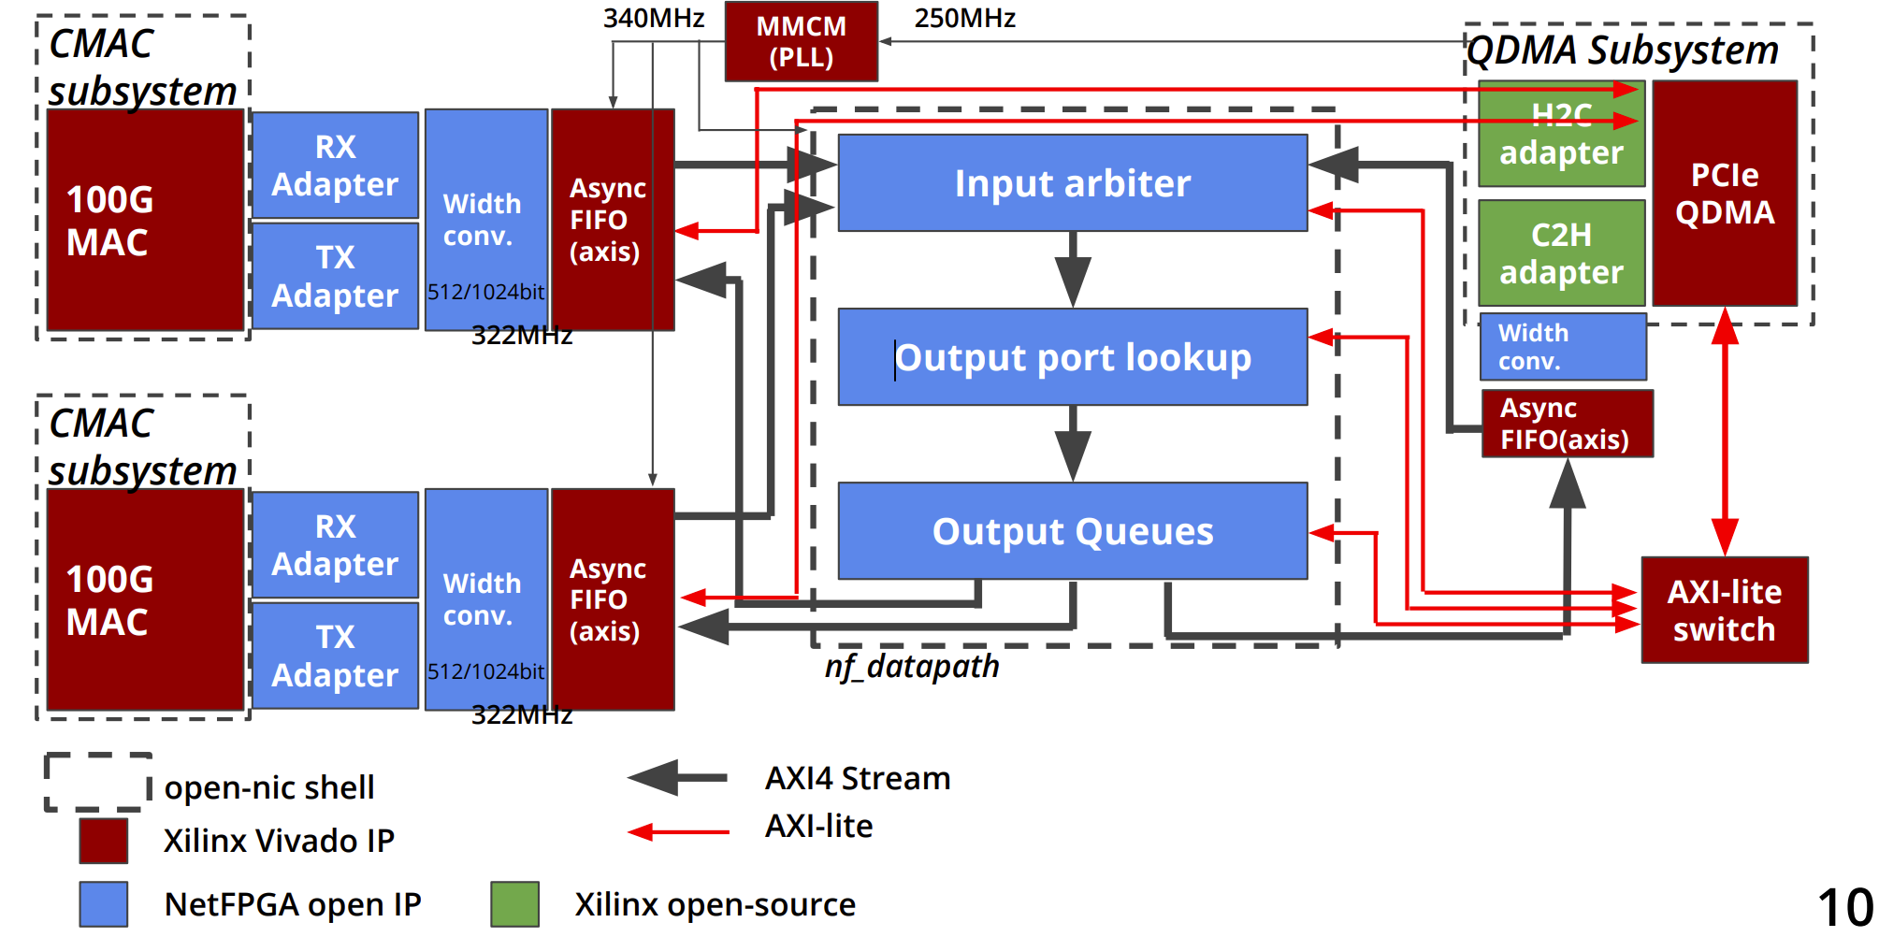

Slide 3
CMAC
OS
NetFPGA Data Path
QDMA
Output Port Lockup
Input Arbiter
Output Queues
Rocket Tile
Rocket Tile
qsfp0_phy_1_inst
riscv_qdma_0
Rocket
Rocket
eth-mac-10g_fifo
L/I
L/D
L/I
L/D
Tile Bus
Tile Bus
L2-FrontBus
BSCAN
AXI LITE SLAVE
BSCAN
System Bus（RISC-V）
L2 Bank
L2 Bank
qsfp0_phy_1_inst
riscv_qdma_0
Control Bus
Periphery Bus
Ethernet
PCIe
BootRom
RX
TX
PHY MDIO
IIC
SD
DDR
UART
AXI LITE SLAVE
AXI Master Interface
BSCAN
Memory
QSFP
QDMA
JTAG

Slide 4
Rocket Tile
Rocket Tile
qsfp0_phy_1_inst
riscv_qdma_0
Rocket
Rocket
eth-mac-10g_fifo
L/I
L/D
L/I
L/D
AXI LITE SLAVE
Tile Bus
Tile Bus
L2-Bank
BSCAN
AXI LITE SLAVE
BSCAN
System Bus（RISC-V）
L2 Bank
L2 Bank
qsfp0_phy_1_inst
riscv_qdma_0
Control Bus
Periphery Bus
Ethernet
PCIe
BootRom
RX
TX
PHY MDIO
IIC
SD
DDR
UART
AXI LITE SLAVE
AXI Master Interface
BSCAN
Memory
QSFP
QDMA
JTAG

